Slide 1

A&B Co. Current Market Summary & Developments
Exploratory Data Analysis on current business trajectories and customer satisfaction
Last Updated: November 21st, 2022

Slide 2
Table of Contents
Introducing our Goals
Summary of Sales Trajectories
Summary of Customer Satisfaction
Conclusions

Slide 3
Introducing our Goals

Slide 4
Goals for our Discussion
We want to know a summary of sales and operations so far:
Is Customer Satisfaction Correlated to Sales?
How Have our Sales Changed Over Time?
Are our Customers Satisfied?
Notes:
In this presentation, I will be providing a summary of sales and operations thus far by exploring how the sales have changed overtime, changes in customer satisfaction, and whether customer satisfaction is a reasonable indicator of sales.
At the end, we will also explore different ways the company can improve on sales and operations based on our findings.

Slide 5
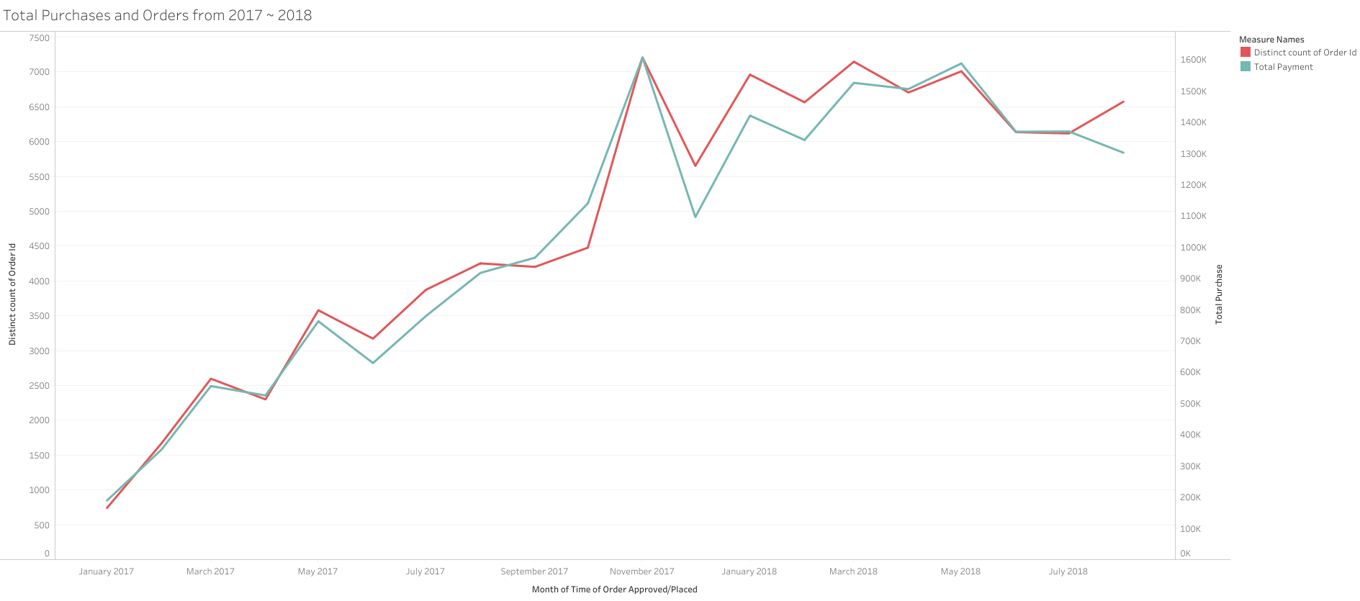
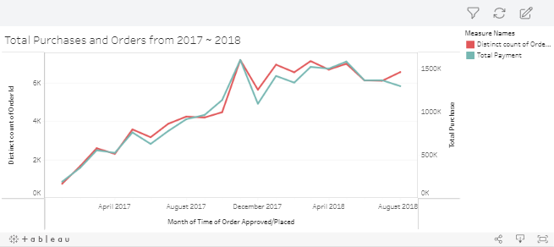
Summary of Sales Trajectories
Both the Number of Orders and Sales have increased over time
Decrease of Sale in recent months
Notes:
A combination of 7 separate datasets were used for the preliminary analysis (Orders dataset, Order items dataset, Order payments dataset, Product dataset, Product category name translated dataset, Order reviews dataset, Customers dataset dataset). Since sales and operations are the primary interests, only the relevant columns such as payment values (often equivalent to the total payment), product names, reviews, customer residence, price, freight values were included in the combined data frame. Product ID and order ID were included as well as they are key identifiers of orders and products.
The first figure (Total purchases and orders from 2017 ~ 2018) illustrates the historical trend of total sales and orders placed from the company’s inception to present (the case study assumes that it is currently September of 2018). This figure aims to provide a summary of the company’s financial performance at a glance using a combined line graph. Although both total sales and number of orders placed follow a similar pattern, it should be noted that the frequency of orders placed are labelled on the left side and the total sales/purchases are labelled on the right side.
From a glance, we can tell that both factors exhibit similar trends. This is likely because quantities of orders placed means more purchases and thus higher sales (rho = 0.93). And although both number of orders and sales have increased steadily overtime, we do see a decrease in sale in recent months starting from May of 2018. Even more interesting is how the number of orders placed in August 2018 are negatively correlated from total sales, a pattern unlike the rest of trend.

Slide 6
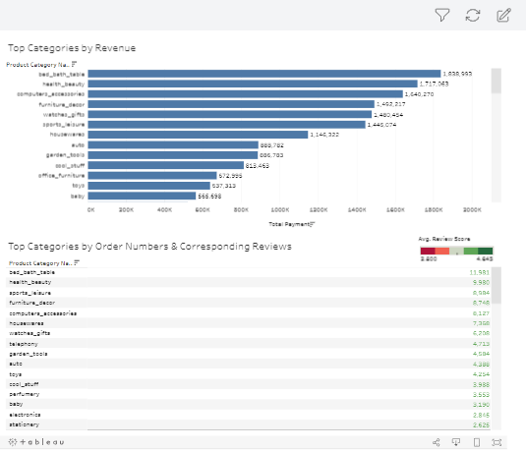
Sales by Item
Categories
Bed, Bath, Furniture, Health and Beauty products among the most profitable and popular items
Diapers and Hygiene, Security and Services record the lowest reviews
Notes:
Moving on, I have explored how sales differ by item categories. The categories on the top figure are sorted based on revenue/sales whereas the bottom table are sorted based on total number of orders placed along with their corresponding reviews from customers.
The key takeaway from this slide is the overlap between the two figures. Similar to how sales and number of orders placed were usually identical in the earlier slide, we see a similar pattern yet again where popular items are often the ones with the highest revenue. This includes but are not limited to: bed/bath/tables, health and beauty products, computer accessories, furniture decors, and sports/leisure products.
We can also observe on which areas the customers are least satisfied with, to which diapers/hygiene products and security and services products seem to be the least satisfactory.
This information can be useful moving forward as it shows on which areas we are already doing well and thus should prioritize, and which areas we can improve/prioritize less on based on sales.

Slide 7
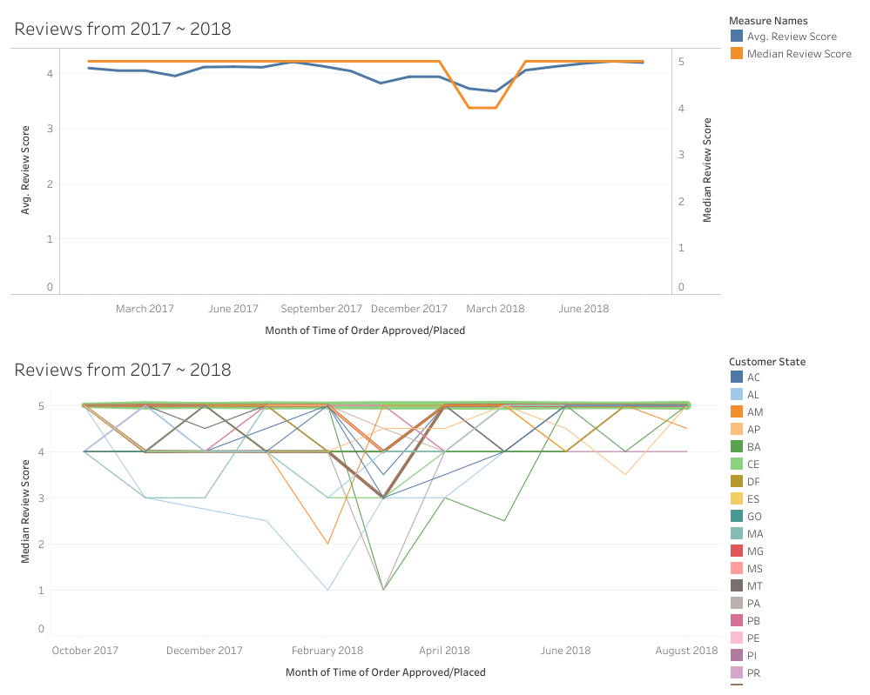
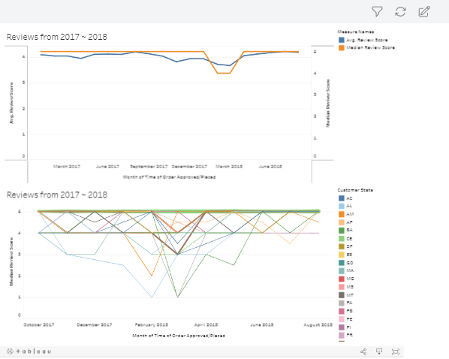
Summary of Customer Satisfaction
Overall positive trend
Decrease in reviews between October 2017 to March 2018
RJ, MG, and SC among top contributor to decrease in rating
Notes:
Next, we look at the overall customer satisfaction via some more line graphs illustrating trend of customer satisfaction.
Both median and average review score was used to explore changes in reviews from 2017 to 2018 and this decision was made because the distribution of review is left skewed (to which the median is more robust to than an average). However, we do see an overall similar trend with the average being able to draw out the smaller changes to the reviews than the median (we actually prefer average because we want to know all the existing outliers/track small details).
Looking at the average reviews then, we see a noticeable drop in customer rating/satisfaction between October 2017 to March 2018 with the lowest average rating being 3.6756. The second figure on the bottom explores this phenomenon in greater detail as it shows which state is most responsible for this drop. The thickness of the line indicate the number of reviews from the said region, and based on the dips & thickness of the lines, we observe that RJ (Rio de Janeiro), MG (Minas Gerais), and SC (Santa Catarina) are among the regions which contribute the most to the drop in reviews. There are other regions where the drops are much more apparent and although they make up a very smaller number of reviews to the overall size, the extreme outliers could have also been responsible for the drop in average reviews (given how average is not robust to outliers)

Slide 8
Conclusions

Slide 9
Summary of Current Business Progress
Steady historical growth, but signs of losses in revenue in recent months
Beds, Baths, Furniture, and Health and Beauty products among the most popular and profitable goods
Notes:
To recap, we have discovered that total sales and number of orders both indicate a steady growth, however, recent months (May to present) indicate a stagnation/decrease in sales despite the number of orders recovering in the last month. This is something of an anomaly as this inverse relationship (between sales and orders) was not recorded in the past.
We have also seen that beds/baths/tables, furniture décor, health and beauty products, computer accessories, and sports/leisure items to be the most successful in both revenue and general popularity.

Slide 10
Summary of Current Customer Satisfaction
Generally positive reception by consumers, but lower ratings were observed during October 2017 to March 2018
Customer satisfaction and sales are unlikely to be correlated (ρ = -0.0865)
Notes:
We have also seen a general positive customer reviews of company’s products, however, a drop is observed during the months of October 2017 to March 2018. This may be attributed to the drops seen from regions such as RJ (Rio de Janeiro), MG (Minas Gerais), SC (Santa Catarina) and in some parts, RR(Roraima), PA(Pará), and SE(Sergipe)
We also see that customer satisfaction and sales are in fact not likely to be correlated with a Pearson correlation score of -0.0865

Slide 11


Moving Forward
Implement marketing strategies to increase sales; possibly by incorporating items that are most popular/profitable
Determine cause of decreased rating during the October to March to address issues from consumers
Notes:
Moving forward, based on what we know, we can hope to increase the decreasing sales by implementing marketing strategies to sell/improve on products that are already doing well (such as beauty products and computer accessories) and relying on their existing success. Alternatively, it can aim to improve on other items that are poorly received in hopes of boosting sales in areas where it was previously unsuccessful.
In another note, determining the cause of the decreased rating during the October to March can help to address issues that the consumers had in those months and implement preventative measures to increase customer ratings and maintain customer retention rates.
One thing that we can explore during the analysis is “how the products, regions, reviews impact the total sale as well as creating a predictive model based on these variables to determine a workable improvement to company sale”

